Slide 1
Talk to Your Packets: AI-Powered Natural Language Interaction with Packet Captures
John Capobianco
@john_capobianco

Slide 2

Let me introduce myself
25 Years in IT
Started network automation in 2014
Directly led to adoption of AI in 2022
Head of DevRel at Selector AI
And these are my socials:
@john_capobianco (X)
@automateyournetwork (Bsky)
john-capobianco-644a1515 (LinkedIn)
automateyournetwork.ca

Slide 3
Not to distract you during the presentation; but please try
Packet Copilot: packetcopilot.selector.ai
And ask yourself – how is this done?

Slide 4
What is Retrieval Augmented Generation?
The Stages of AI
1.0 - GUI / API
1.5 - RAG
2.0 - Agents
Retrieval Augmented Generation
6 Step Process
Embeddings (Vectors)
Storage
Retrieval
RAG-Fusion
Multi-query
Reciprocal Ranking

Slide 5
What is Retrieval Augmented Generation?
The Stages of AI
1.0 - GUI / API
1.5 - RAG
2.0 - Agents
Retrieval Augmented Generation
6 Step Process
Embeddings (Vectors)
Storage
Retrieval
RAG-Fusion
Multi-query
Reciprocal Ranking

Slide 6
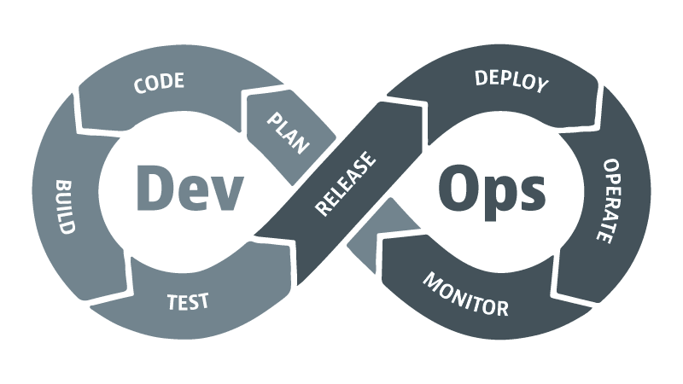
Evolution of Operations
Traditional Operations
Syslog, SNMP
Manual effort
Reactive
DevOps
Agile
CI/CD
Break down silos
NetDevOps
Infrastructure as Code
Automation
AIOps
Augmented with AI
Closed Loop
VibeOps (?)
MCP
Agents

Slide 7
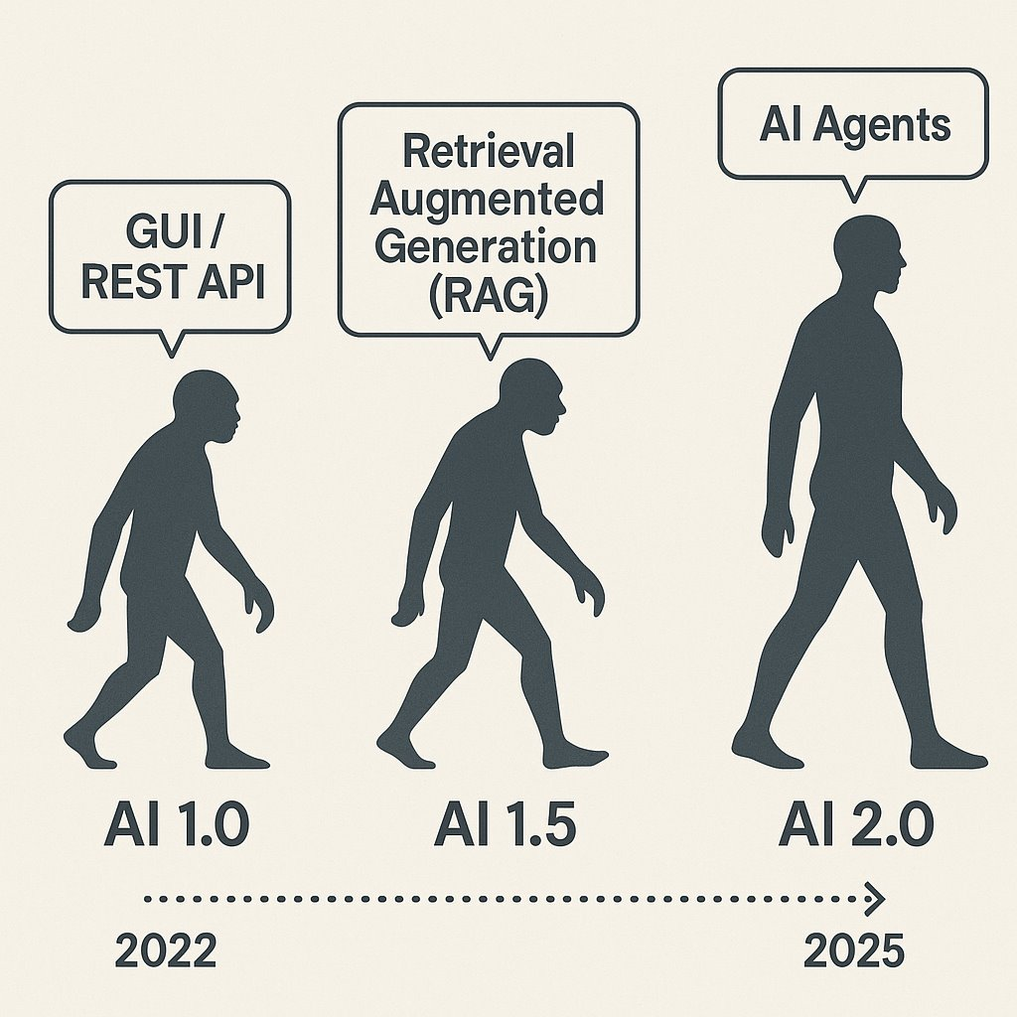

Slide 8
AI 1.0: GUI / API
The beginning of modern AI integration into workflows. Interfaces were built around graphical user interfaces (GUI) and REST APIs. Systems were reactive, rule-based, and required precise inputs.
Characteristics:
Manual interactions via UI
Predefined API endpoints
No contextual understanding
Automation limited to basic scripting

Slide 9
AI 1.5: Retrieval Augmented Generation (RAG)
A leap in capability with large language models able to retrieve and reason over external data. Systems began to offer contextual responses grounded in current or proprietary knowledge.
Characteristics:
Combines LLMs with external data sources
Supports context-aware Q&A
Introduces knowledge grounding
Still linear, not autonomous

Slide 10
AI 2.0: AI Agents
The emergence of autonomous, goal-driven agents capable of planning, reasoning, and taking actions across multiple tools. Systems evolve from stateless prompts to stateful workflows.
Characteristics:
Task orchestration and tool use
Memory and planning
Multi-step reasoning
Autonomous execution across APIs, files, and platforms

Slide 11
AI 2.0: AI Agents
The emergence of autonomous, goal-driven agents capable of planning, reasoning, and taking actions across multiple tools. Systems evolve from stateless prompts to stateful workflows.
Characteristics:
Task orchestration and tool use
Memory and planning
Multi-step reasoning
Autonomous execution across APIs, files, and platforms

Slide 12
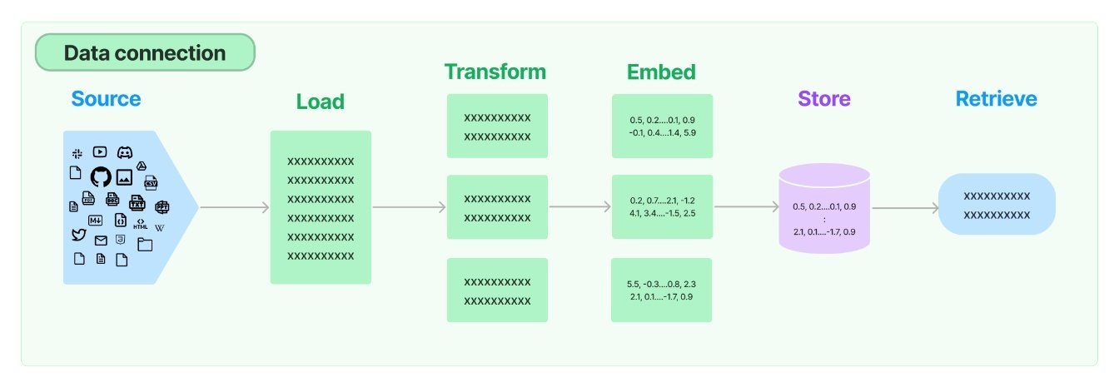
6 Steps of RAG using LangChain

Slide 13
Packet Captures (.pcap; .pcapng)
As of today you cannot upload .pcap / .pcapng to Large Langauge Models (LLMs) directly; (yet)
There are manual processes of exporting your capture to text and then pasting the text into the LLM GUI
Using RAG we can automate this process and provide users the ability to simply upload their capture and start 'talking' to it.
A pre-step, or a 7th intermediate step, in the RAG process is required: transforming the .pcap to JavaScript Object Notation (JSON) allowing us to use a JSONLoader to load the transformed data.
Another good idea is to sanitize / cleanse / cleanup any metadata that is unnecessary such as large HEX fields of data (tcp.data or udp.data fields) before splitting and embedding the data.

Slide 14
1 - Source
The source of the external knowledge you want to augmented the generation of output.
High level categories:
Webpages
PDFs
Cloud Providers
Social Platforms
Messaging Services
Productivity Tools
Common File Types
CSV
Directory of files
Unstructured files
JSON <==== there is no .pcap source; but there is a JSON source
HTML

Slide 15
2 - Load
Once you have a source you need to find the appropriate loader; note there is no .pcap loaded but there is a JSONLoader
Sample code to load a JSON file:
from langchain_community.document_loaders import JSONLoader
file_path='./sample.json'
loader = JSONLoader( file_path=file_path, jq_schema='.quiz', text_content=False)
docs = loader.load()
print(docs[0].page_content[:100])
print(docs[0].metadata)

Slide 16
3 – Split (Transform)
A semantic splitter breaks text into chunks based on meaning, not just size or structure. It uses LLMs or embeddings to find natural boundaries—like a shift in topic, tone, or idea—rather than blindly splitting by paragraphs, headers, or token limits.
📘 Example: Network Engineering Manual
Imagine you're using RAG on a 50-page Cisco IOS XE config guide.
Naive splitter: Splits every 500 tokens. This might:
Split a show ip interface brief explanation halfway.
Mix unrelated topics like BGP and EIGRP in the same chunk.
Semantic splitter: Analyzes where the concept changes and chunks accordingly:
One chunk for show ip interface brief
Another for configure static routing
Another for EIGRP authentication
This ensures each chunk is coherent, self-contained, and relevant to a single question.

Slide 17
4 – Embed (Vectors)
Embedding models transform human language into a format that machines can understand and compare with speed and accuracy.
These models take text as input and produce a fixed-length array of numbers, a numerical fingerprint of the text's semantic meaning.
Embeddings allow search system to find relevant documents not just based on keyword matches, but on semantic understanding.
Input: "How do I configure BGP authentication?"
Output: [0.12, -0.87, 0.45, ..., 0.33] ← fixed-length vector
Similar vectors → semantically similar content

Slide 18
4 – Embed (Vectors)
Embedding models transform human language into a format that machines can understand and compare with speed and accuracy.
These models take text as input and produce a fixed-length array of numbers, a numerical fingerprint of the text's semantic meaning.
Embeddings allow search system to find relevant documents not just based on keyword matches, but on semantic understanding.
Input: "How do I configure BGP authentication?"
Output: [0.12, -0.87, 0.45, ..., 0.33] ← fixed-length vector
Similar vectors → semantically similar content

Slide 19
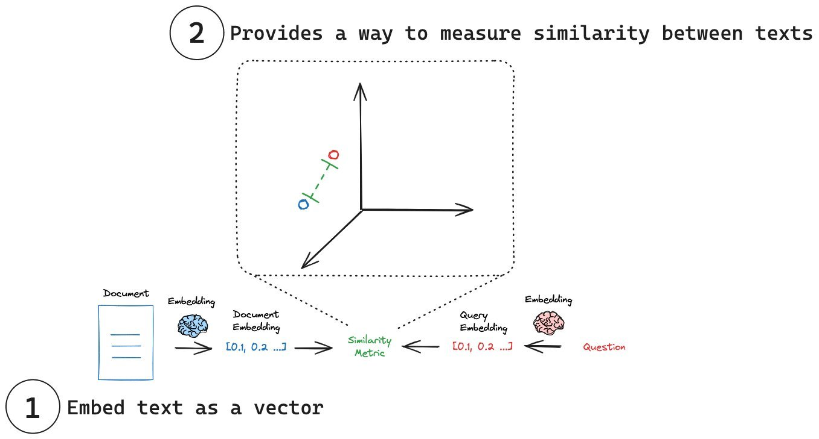

Slide 20
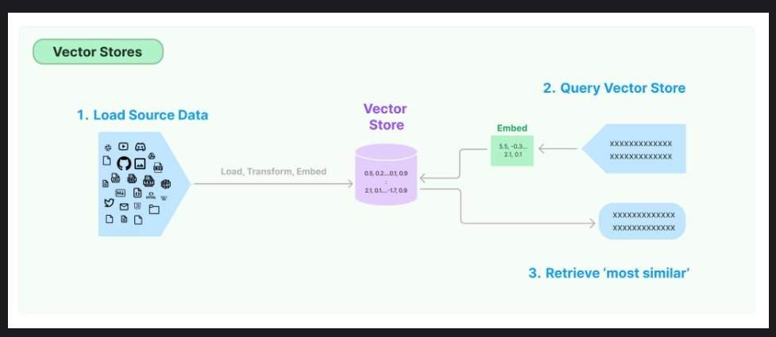
5 - Store
Now that we have lists of floating point numbers, the vectors, we need to store them either in memory or in a database (or both). This database is optimized for storing and searching embeddings (numerical vectors). Enabling fast similarity search to retrieve relevant documents based on semantic meaning.
ChromaDB, FAISS, Weaviate, Pinecone, Elastic, Qdrant, Milvus

Slide 21
6 – Retrieve
Finally the Large Language Model (LLM) gets involved in the process and the prompt is transformed into vectors and a similarity search is performed between the prompt and the vector store returning the closest vectors to augment the generation of output.

Slide 22
How "good" is it?

Slide 23
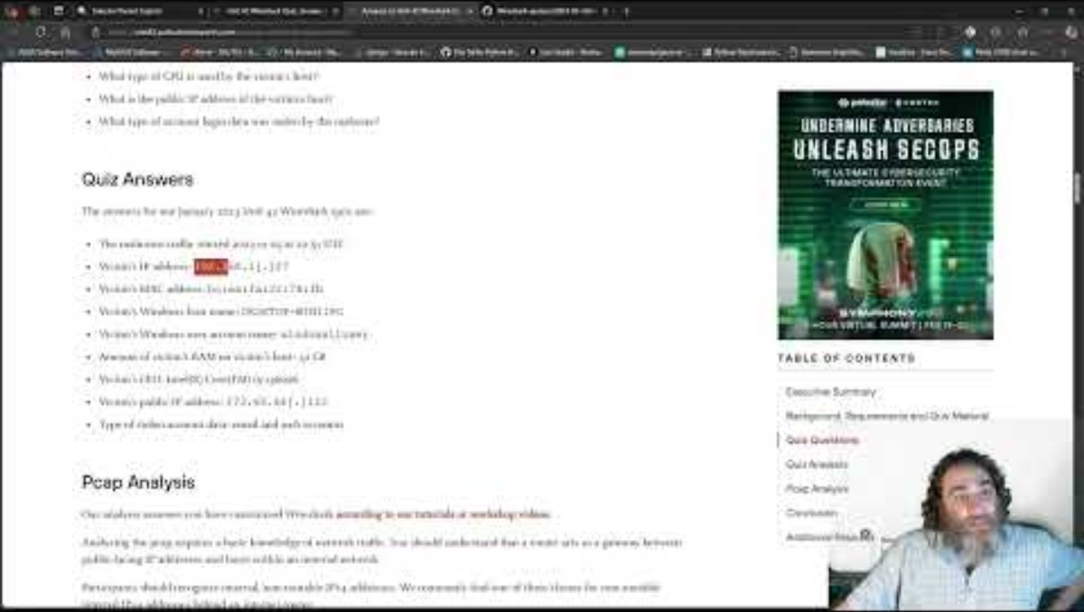
Packet Copilot vs Unit 42's Quiz

Slide 24
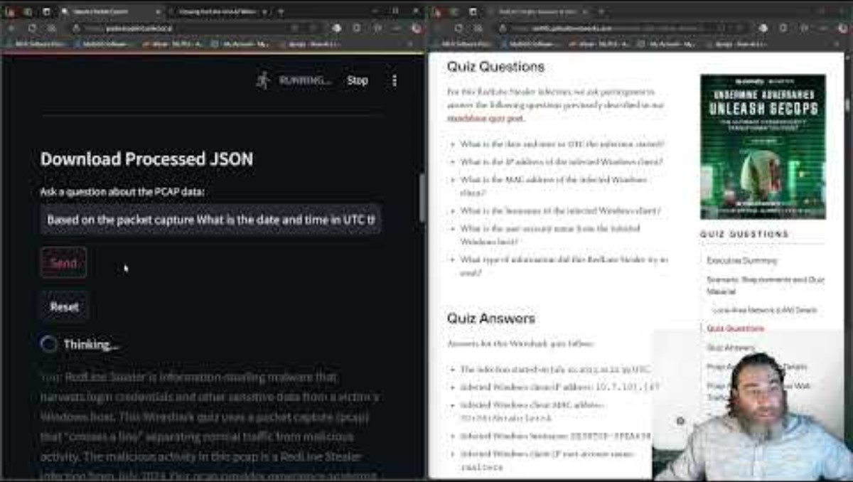
Packet Copilot vs Another Unit 42's Quiz

Slide 25
Not quite perfect – 19 / 20 correct
* Instantaneous using real PCAP data
* 20th question correct with 'better' prompt How many humans could do this with Wireshark?
How long would it take? Is that a task a human should really be doing in the first place?

Slide 26
Multi-Query

Slide 27
People ask stupid questions!
Can we take the users original question and derive +n number of similar questions
Similar or different in:
Tone
Sentiment
Word selection
Sophistication
Technical accuracy
We can use AI to generate additional, similar, prompts to help AI generate the best possible answer to the original prompt

Slide 28
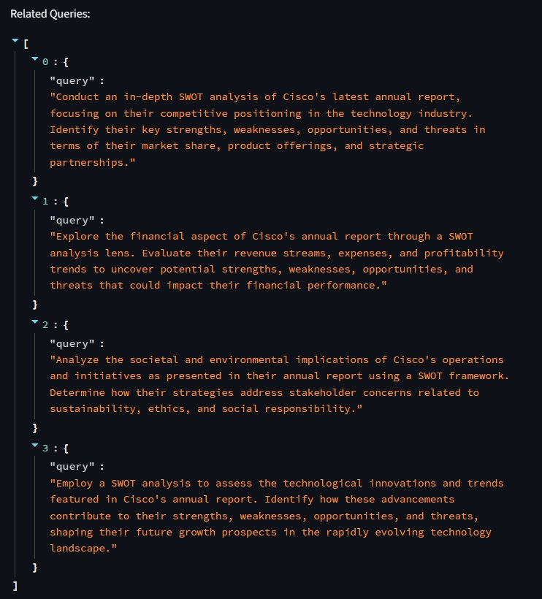

Multi-Query

Slide 29
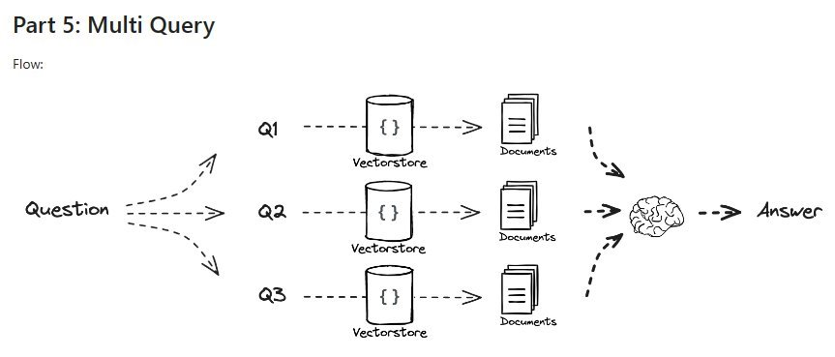
Multi-Query
rag-from-scratch/rag_from_scratch_5_to_9.ipynb at main · langchain-ai/rag-from-scratch · GitHub

Slide 30
RAG Fusion

Slide 31
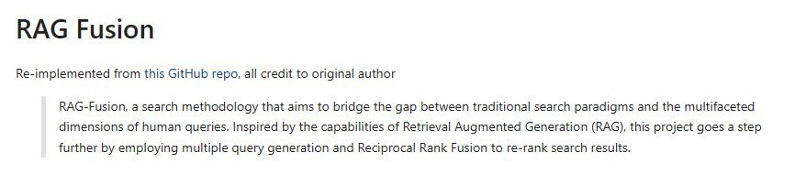
Reciprocal Re-Ranking (Fusion)
langchain/cookbook/rag_fusion.ipynb at master · langchain-ai/langchain · GitHub​

Slide 32
Sythnetic Answers
Going a step further we can use reciprocal ranking and other methods to evaluate and rank the 'best' answers
We can take 'all' answers and synthesize a 'best' answer
We can round-robin against multi-LLM to get different 'perspectives' and generations; and synthesize a multi-LLM council of answers
We can bounce the initial answers from all LLMs against all other LLMs and come to a consensus of the 'best' answer (and throw away outlying hallucinations

Slide 33
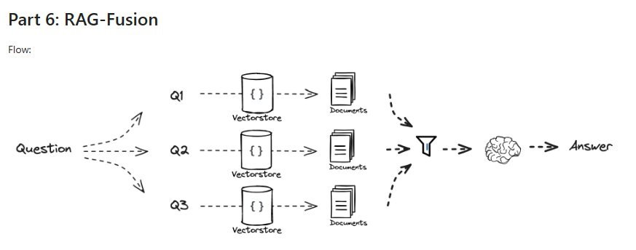
Reciprocal Re-Ranking (Fusion)
rag-from-scratch/rag_from_scratch_5_to_9.ipynb at main · langchain-ai/rag-from-scratch · GitHub

Slide 34
Recursive Abstractive Processing for Tree-Organized Retrieval: RAPTOR

Slide 35
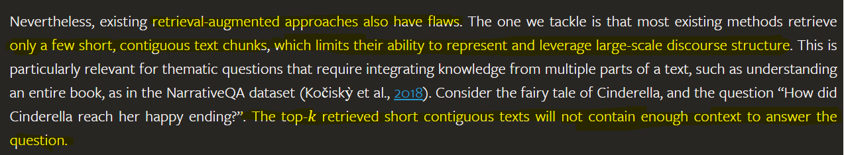
Drawbacks of basic RAG
RAPTOR: Recursive Abstractive Processing for Tree-Organized Retrieval (arxiv.org)

Slide 36
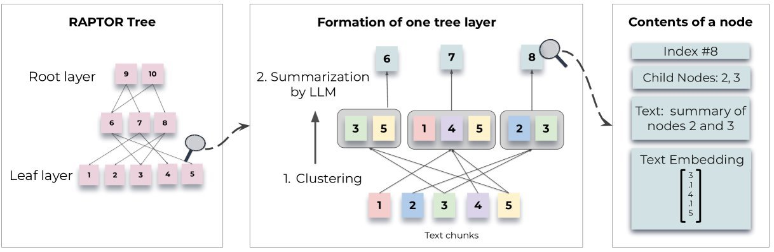
RAPTOR: Remind you of anything? Like a spine-leaf data center
RAPTOR: Recursive Abstractive Processing for Tree-Organized Retrieval (arxiv.org)

Slide 37
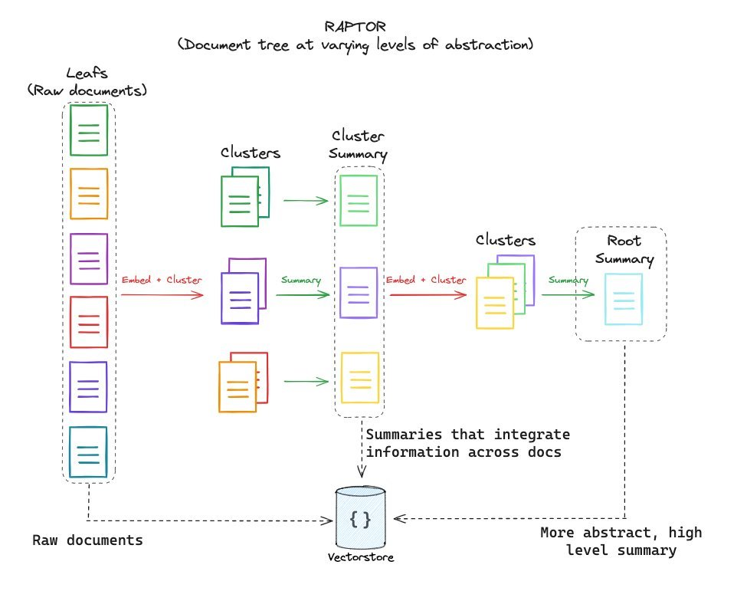
RAPTOR: Remind you of anything? Like a spine-leaf data center
langchain/cookbook/RAPTOR.ipynb at master · langchain-ai/langchain · GitHub

Slide 38
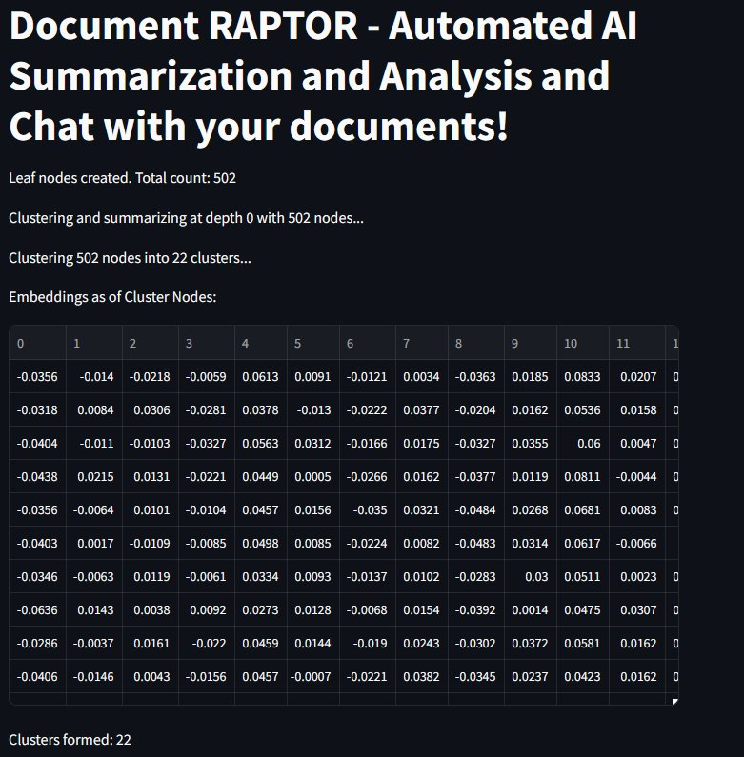
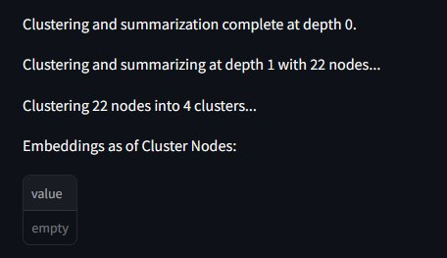
RAPTOR: Remind you of anything? Like a spine-leaf data center
5
LEAF NODEs
22 SPINES
4 SPINES
ROOT

Slide 39
GraphRAG

Slide 40
Knowledge Graphs
Going a step further we can use reciprocal ranking and other methods to evaluate and rank the 'best' answers
We can take 'all' answers and synthesize a 'best' answer
We can round-robin against multi-LLM to get different 'perspectives' and generations; and synthesize a multi-LLM council of answers
We can bounce the initial answers from all LLMs against all other LLMs and come to a consensus of the 'best' answer (and throw away outlying hallucinations

Slide 41
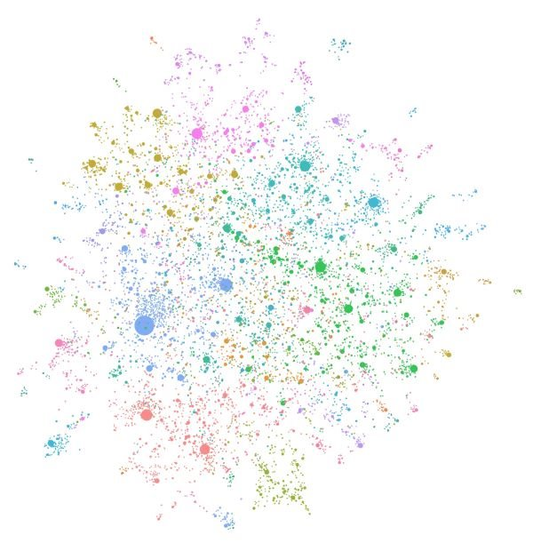
Welcome - GraphRAG

Slide 42
** WARNING **

Slide 43
Please be careful with GraphRAG approaches
As you can imagine these graphs are huge and require a lot of computational and GPU power.
I abandoned my first attempt at GraphRAG after the job / bill reached about $65 – and it wasn't even close to being finished
Local models (LLMs) via tools like Ollama can ease the costs but they will still take substantial amount of time to generate locally unless you have serious GPU access
Be careful with cloud models when trying to build Knowledge Graphs

Slide 44
Table Augmented Generation: TAG

Slide 45
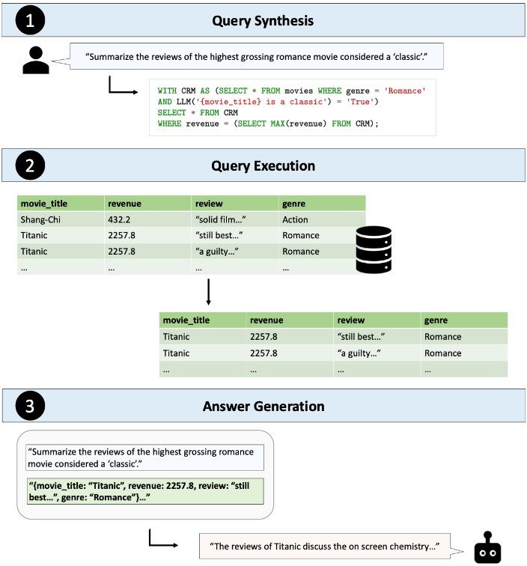
TAG: Beyond Text2SQL
Tabular data is already organized; structured; and can be queried with Structured Query Language (SQL)
Attempts to move to Text2SQL still cumbersome
LLM and a similar approach as RAG lets up lookup Tabular data in a similar way
[2408.14717] Text2SQL is Not Enough: Unifying AI and Databases with TAG

Slide 46
Retrieval Augmented Fine Tuning (RAFT)

Slide 47
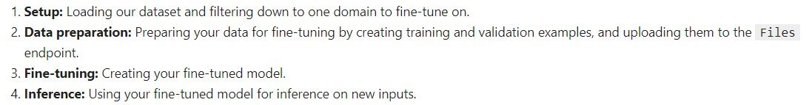
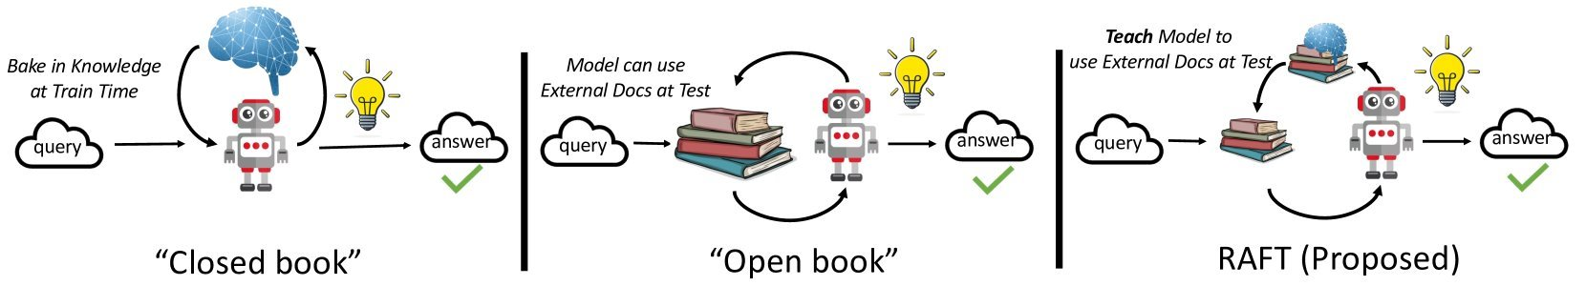
Large Language Models can be Fine Tuned
Fine-tuning is the process of taking a pretrained machine learning model and further training it on a smaller, targeted, domain-specific, data set. The aim of fine-tuning is to maintain the original capabilities of a pretrained model while adapting it to suit more specialized use cases.
RAFT: Adapting Language Model to Domain Specific RAG (arxiv.org)
RAFT (Retrieval Augmented Fine-tuning): A new way to teach LLMs (Large Language Models) to be better at RAG (Retrieval Augmented Generation) (microsoft.com)

Slide 48
Agentic RAG

Slide 49
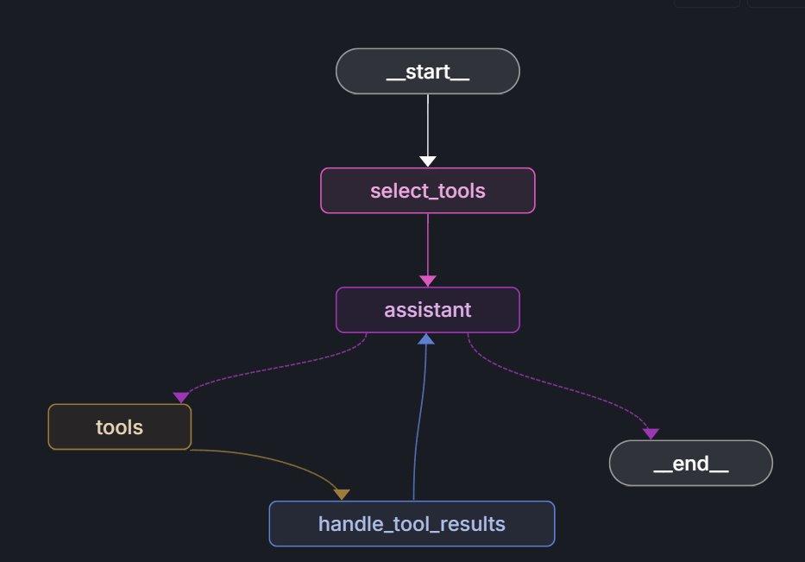
Model Context Protocol (MCP) has tool discovery Discover tool names and pydantic descriptions
6
RAG

Slide 50
Resources

Slide 51
Open Source Resources
Buddies – Document, Packet
automateyournetwork/Document_Buddy: Chat with various documents - XLSX, DOCX, PPTX, CSV, PDF, TXT - using chatGPT 4 Turbo and Langchain automateyournetwork/packet_buddy: pcap analysis provided by chatGPT4 Turbo
RAPTORs – Document, Packet automateyournetwork/Document_RAPTOR: A RAPTOR Tree of your documents used for Language Model Retrieval to chat with the documents!
automateyournetwork/packet_raptor: An AI Assistant using RAPTOR to talk to .pcaps
Knowledge Graphs (GraphRAG) - Document, Packet
automateyournetwork/Document_graphRAG: graphRAG approach with .pcap
automateyournetwork/packet_graph: A Knowledge Graph of a .pcap Packet Capture!
TAG - Packet automateyournetwork/Packet_TAG: Table Augmented Generation (TAG) with Packet Captures (.pcaps/pcapng)

Slide 52
Live Demo Q&A

